Slide 1

GETSMART Executive Stakeholder
Showcasing key features for leadership stakeholders
Notes:
AI-generated content may be incorrect. ---

Slide 2
Introduction and Executive Context
Notes:
--- This slide references information from the following file: https://eu-prod.asyncgw.teams.microsoft.com/v1/objects/0-weu-d7-90035fd2913cc3b92046362f91cc3fb9/views/original/enhanced_getsmart.js GETSMART AI Assistant – Stakeholder Live Demo

Slide 3

GETSMART AI Assistant – Stakeholder Live Demo
Unified AI Workspace
GETSMART integrates five AI workflows into a single cohesive platform with one interface and security model.
Architectural Maturity and Security
The platform demonstrates robust architecture and strong security posture essential for enterprise adoption.
Business Impact and Productivity
GETSMART addresses inefficiencies and governance concerns, boosting productivity and reducing costs.
Consultation-Style Presentation
The demo focuses on outcomes, scalability, and readiness rather than conceptual AI experiments.
Notes:
--- This slide references information from the following file: https://eu-prod.asyncgw.teams.microsoft.com/v1/objects/0-weu-d7-90035fd2913cc3b92046362f91cc3fb9/views/original/enhanced_getsmart.js This opening slide establishes the executive context for the GETSMART AI Assistant by positioning it as a unified, production-ready AI workspace designed for modern knowledge workers and organizations. The intent of the presentation is to guide stakeholders through a live demo and prototype walkthrough, demonstrating not only functional capabilities but also architectural maturity, security posture, and business impact. GETSMART consolidates five high-value AI workflows—AI Chat, AI Planner, Task Research, Document Assistant, and Smart Notes—into a single, cohesive platform. Instead of forcing users to switch between multiple disconnected tools, GETSMART provides one consistent interface, one security model, and one deployment surface. From an executive perspective, this directly addresses inefficiencies, governance concerns, and cost overhead introduced by fragmented AI adoption. The slide also frames the session expectations: a concise walkthrough of the live prototype, an explanation of how the system is built and secured, and a discussion on the tangible productivity and operational benefits. This sets the tone for a consultation-style presentation, focusing on outcomes, scalability, and readiness rather than experimental or conceptual AI usage.

Slide 4
Executive Summary and Business Framing
Notes:
--- This slide references information from the following file: https://eu-prod.asyncgw.teams.microsoft.com/v1/objects/0-weu-d7-90035fd2913cc3b92046362f91cc3fb9/views/original/enhanced_getsmart.js Executive Summary

Slide 5

Executive Summary
Consolidated AI Workflows
Five AI workflows are integrated into a single workspace, reducing tool sprawl and simplifying user experience.
Production-Ready System
GETSMART is deployable today on modern platforms like Vercel and Lovable Cloud, not just a prototype.
Governed and Secure Design
Security is built-in with server-only prompts, strict validation, and rate limiting across all AI interactions.
Model-Agnostic Flexibility
Organizations can switch AI vendors easily, supporting Gemini, GPT, or Claude models for flexibility.
Notes:
--- This slide references information from the following file: https://eu-prod.asyncgw.teams.microsoft.com/v1/objects/0-weu-d7-90035fd2913cc3b92046362f91cc3fb9/views/original/enhanced_getsmart.js The executive summary distills the GETSMART value proposition into clear, decision-oriented points. First, it emphasizes consolidation: five distinct AI workflows are delivered through a single, unified workspace, reducing tool sprawl and cognitive load. Second, it highlights that GETSMART is not a prototype-only concept but a production-ready system, built with modern infrastructure and deployable today on platforms such as Vercel or Lovable Cloud. Third, the solution is governed and secure by design, with server-only system prompts, strict validation, and rate limiting applied uniformly across all AI interactions. Finally, GETSMART is model-agnostic, meaning organizations are not locked into a single AI vendor and can switch between Gemini, GPT, or Claude with minimal effort. For executives, these points translate into faster time-to-value, reduced operational risk, predictable AI costs, and future-proof flexibility. The summary prepares stakeholders to view the subsequent demo and technical details through the lens of business enablement rather than technical novelty.

Slide 6
Problem Statement
Notes:
--- This slide references information from the following file: https://eu-prod.asyncgw.teams.microsoft.com/v1/objects/0-weu-d7-90035fd2913cc3b92046362f91cc3fb9/views/original/enhanced_getsmart.js The Business Challenge

Slide 7

The Business Challenge
Fragmented AI Tool Usage
Users rely on multiple AI applications causing duplicated prompts and lost conversational context.
Security and Compliance Risks
Each AI tool has separate authentication, data policies, and vendor lock-in risks increasing security exposure.
Governance and Cost Challenges
Fragmentation leads to governance difficulties and unpredictable costs across tools in organizations.
Reduced Productivity
Users waste time switching tabs and transferring outputs, lowering overall work efficiency.
Notes:
--- This slide references information from the following file: https://eu-prod.asyncgw.teams.microsoft.com/v1/objects/0-weu-d7-90035fd2913cc3b92046362f91cc3fb9/views/original/enhanced_getsmart.js This slide articulates the core business problem GETSMART addresses: fragmented AI usage across multiple tools. In many organizations, users rely on four to six separate AI applications to complete daily tasks such as chatting, planning, researching, document analysis, and note-taking. This fragmentation leads to duplicated prompts, lost conversational context, inconsistent outputs, and increased security exposure. Each tool often comes with its own authentication model, rate limits, data retention policies, and vendor lock-in risks. From a management perspective, this creates governance challenges and unpredictable cost structures. Additionally, productivity suffers as users waste time switching tabs, re-explaining context, and manually transferring outputs between tools. By clearly stating this challenge, the slide frames GETSMART as a response to a real operational inefficiency rather than a feature-driven AI product. It also creates alignment with stakeholder pain points around security, compliance, user efficiency, and platform standardization.

Slide 8
Solution Overview
Notes:
--- This slide references information from the following file: https://eu-prod.asyncgw.teams.microsoft.com/v1/objects/0-weu-d7-90035fd2913cc3b92046362f91cc3fb9/views/original/enhanced_getsmart.js GETSMART Platform Overview

Slide 9
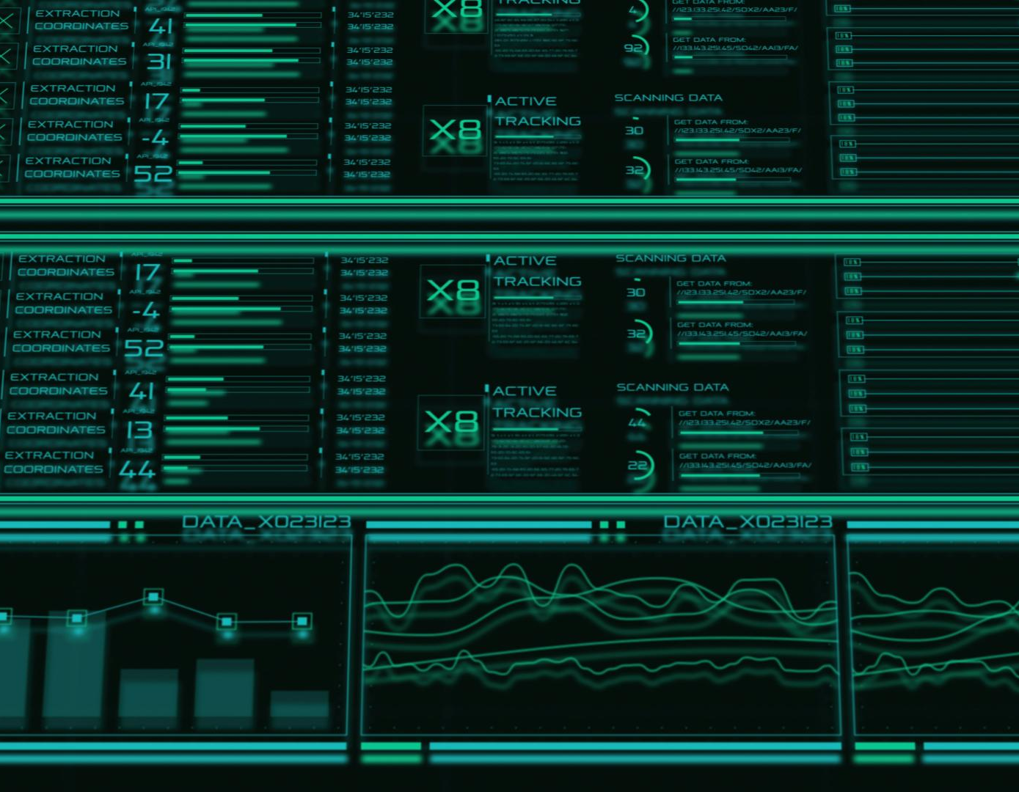
GETSMART Platform Overview
AI Chat Module
Provides threaded, streaming conversations to support exploratory thinking and effective problem solving.
AI Planner Module
Transforms goals into structured plans with actionable time blocks for day, week, month, or year.
Task Research Module
Generates long-form, sectioned research reports with references for deeper analysis without manual work.
Document Assistant & Smart Notes
Allows PDF uploads for Q&A, summarization, extraction, and offers AI-assisted markdown editing for content enhancement.
Notes:
--- This slide references information from the following file: https://eu-prod.asyncgw.teams.microsoft.com/v1/objects/0-weu-d7-90035fd2913cc3b92046362f91cc3fb9/views/original/enhanced_getsmart.js This section introduces GETSMART as an integrated platform composed of five tightly connected AI modules. AI Chat provides threaded, streaming conversations suitable for exploratory thinking and problem solving. AI Planner transforms goals into structured day, week, month, or year plans rendered as actionable time blocks. Task Research generates long-form, sectioned research reports with references, enabling deeper analysis without manual synthesis. The Document Assistant allows users to upload PDFs and perform question answering, summarization, and extraction tasks. Smart Notes offers an AI-assisted markdown editor for rewriting, translating, and expanding content. The key differentiator highlighted here is that all modules share the same underlying primitives, security controls, and gateway, ensuring consistency across the user experience. For stakeholders, this demonstrates architectural discipline and reduces concerns about siloed features or duplicated logic.

Slide 10
Live Demo Walkthrough
Notes:
--- This slide references information from the following file: https://eu-prod.asyncgw.teams.microsoft.com/v1/objects/0-weu-d7-90035fd2913cc3b92046362f91cc3fb9/views/original/enhanced_getsmart.js Prototype Walkthrough Flow

Slide 11
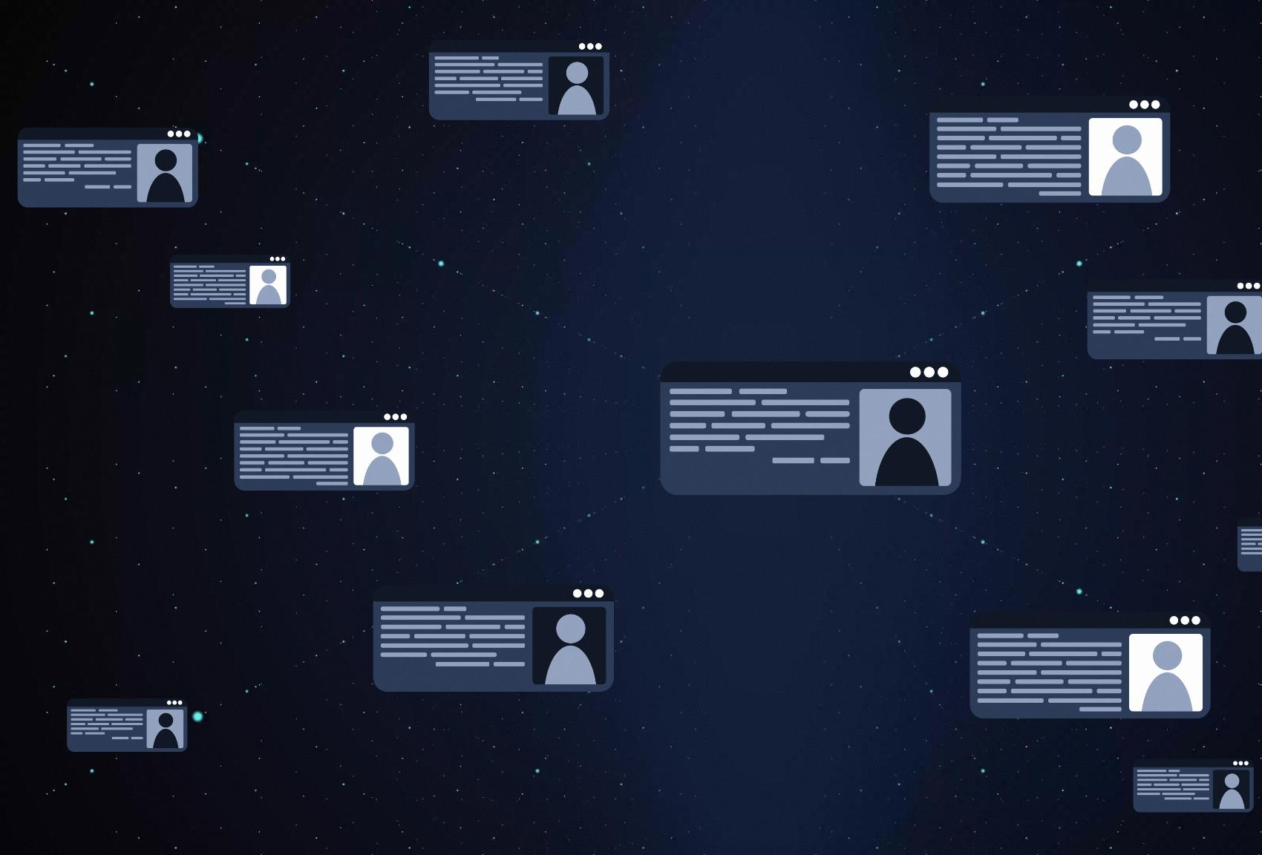
Prototype Walkthrough Flow
Unified Workspace Overview
The demo starts on the home page with a five-module grid highlighting a seamless, integrated workspace.
AI Chat and Real-time Interaction
AI Chat module demonstrates live streaming responses and rich markdown rendering for dynamic communication.
Planner Module for Goal Setting
Planner generates structured AI-driven plans from concrete goals to organize tasks effectively.
Research and Document Assistance
Research module creates detailed reports with clear sections, while Document Assistant supports PDF upload and question answering.
Notes:
--- This slide references information from the following file: https://eu-prod.asyncgw.teams.microsoft.com/v1/objects/0-weu-d7-90035fd2913cc3b92046362f91cc3fb9/views/original/enhanced_getsmart.js The live demo walkthrough outlines the exact narrative followed during the stakeholder demonstration. It begins on the home page, showcasing the five-module grid and reinforcing the idea of a unified workspace. The presenter then moves into AI Chat to demonstrate real-time streaming responses and rich markdown rendering. Next, the Planner module is used to generate a realistic plan from a concrete goal, highlighting structured AI output. The Research module follows, illustrating how deep reports are generated with clear sections and references. The Document Assistant demo shows PDF upload and targeted question answering, while Smart Notes concludes the walkthrough by applying rewrite or translation actions directly within a note. The flow is intentionally designed to escalate in perceived value and complexity, ending with a recap that ties usability back to business impact. This narrative-driven demo ensures stakeholders understand not just what the product does, but how it fits into real workflows.

Slide 12
Architecture and Technology
Notes:
--- This slide references information from the following file: https://eu-prod.asyncgw.teams.microsoft.com/v1/objects/0-weu-d7-90035fd2913cc3b92046362f91cc3fb9/views/original/enhanced_getsmart.js Solution Architecture Overview

Slide 13
Solution Architecture Overview
Module | Endpoint | Type | Rate Limit
Chat | POST /api/chat | Streaming SSE | 20/min
Research | generateResearch | Server Function | 5/min
Planner | generatePlan | Server Function | 10/min
Documents | documentAction | Server Function | 10/min
Notes | noteAction | Server Function | 15/min
Notes:
--- This slide references information from the following file: https://eu-prod.asyncgw.teams.microsoft.com/v1/objects/0-weu-d7-90035fd2913cc3b92046362f91cc3fb9/views/original/enhanced_getsmart.js This slide explains the high-level architecture that underpins GETSMART, focusing on clarity and scalability rather than low-level implementation details. The browser layer is built with React 19 and TanStack Start, providing a modern, responsive user interface with server-side rendering support. Requests flow through a typed server runtime that handles validation, streaming, and rate limiting before reaching the Lovable AI Gateway. This gateway abstracts AI providers behind an OpenAI-compatible interface, enabling seamless switching between Gemini, GPT, and Claude models. The architecture is designed to run on edge or Node environments, supporting low-latency interactions and cloud-native deployment. For stakeholders, this architecture demonstrates maturity, vendor flexibility, and readiness for scale without requiring a rewrite as usage grows.

Slide 14
Security and Governance
Notes:
--- This slide references information from the following file: https://eu-prod.asyncgw.teams.microsoft.com/v1/objects/0-weu-d7-90035fd2913cc3b92046362f91cc3fb9/views/original/enhanced_getsmart.js Security & Governance Model

Slide 15
Security & Governance Model
Challenge | Solution
Prompt injection | Server-only system prompts with sanitized inputs
AI cost overruns | Per-IP rate limiting and payload caps
Streaming complexity | AI SDK v7 with edge-compatible streaming
State fragmentation | Shared primitives across all modules
Deferred authentication | Auth-ready server middleware
Notes:
--- This slide references information from the following file: https://eu-prod.asyncgw.teams.microsoft.com/v1/objects/0-weu-d7-90035fd2913cc3b92046362f91cc3fb9/views/original/enhanced_getsmart.js Security and governance are presented as first-class concerns in GETSMART rather than afterthoughts. All system prompts are enforced server-side, preventing client manipulation or prompt injection. Zod validation ensures that every AI request conforms to strict length and schema limits, reducing abuse and unexpected costs. Per-IP sliding-window rate limiting protects AI endpoints from overload and cost spikes, while payload caps enforce predictable resource usage. Environment isolation ensures that API keys and secrets never reach the client. Importantly, the system is auth-ready, allowing enterprise authentication to be introduced without refactoring core logic. This slide reassures stakeholders that GETSMART can operate safely within corporate and regulated environments.

Slide 16
Business Impact
Notes:
--- This slide references information from the following file: https://eu-prod.asyncgw.teams.microsoft.com/v1/objects/0-weu-d7-90035fd2913cc3b92046362f91cc3fb9/views/original/enhanced_getsmart.js Impact & Benefits

Slide 17
Impact & Benefits
Dimension | Before | With GETSMART
Tools in workflow | 4–6 separate apps | 1 unified workspace
Time to first result | ~3 minutes | ~15 seconds
Prompt history | Fragmented | Persistent & threaded
Security governance | Inconsistent | Uniform & enforced
Model swap cost | High | One-line change
Notes:
--- This slide references information from the following file: https://eu-prod.asyncgw.teams.microsoft.com/v1/objects/0-weu-d7-90035fd2913cc3b92046362f91cc3fb9/views/original/enhanced_getsmart.js This slide translates technical capabilities into measurable business outcomes. GETSMART reduces the number of AI tools in a typical workflow from four to six down to a single platform, simplifying procurement and governance. Time to first result on a new task drops dramatically, from several minutes of context switching to seconds within a unified interface. Persistent, threaded history improves knowledge continuity and reuse across tasks. Model-agnostic design lowers future switching costs and avoids vendor lock-in. Finally, rapid deployment—often under five minutes—reduces operational friction and accelerates experimentation. Together, these benefits position GETSMART as a productivity multiplier rather than just another AI tool.

Slide 18
Audience and Next Steps
Notes:
--- This slide references information from the following file: https://eu-prod.asyncgw.teams.microsoft.com/v1/objects/0-weu-d7-90035fd2913cc3b92046362f91cc3fb9/views/original/enhanced_getsmart.js Target Users, Live Demo and Q&A

Slide 19

Target Users, Live Demo and Q&A
Primary Target Users
GETSMART targets founders, product managers, researchers, students, and consultants using AI workflows daily.
Live Prototype Demonstration
The live demo allows stakeholders to directly explore GETSMART’s features and capabilities post-presentation.
Interactive Q&A Session
The session closes with an invitation for questions, feedback, and roadmap discussions to shape platform evolution.
Notes:
--- This slide references information from the following file: https://eu-prod.asyncgw.teams.microsoft.com/v1/objects/0-weu-d7-90035fd2913cc3b92046362f91cc3fb9/views/original/enhanced_getsmart.js The closing slide identifies the primary target users for GETSMART, including founders, product managers, researchers, students, and consultants—anyone who runs multiple AI-assisted workflows daily. It reinforces that the prototype is live and accessible, enabling stakeholders to explore the product firsthand after the presentation. The session concludes with an invitation for questions, feedback, and roadmap discussion, positioning GETSMART as an evolving platform shaped by stakeholder input. This ending reinforces confidence, transparency, and readiness for next steps such as pilot adoption or deeper technical evaluation.

